Slide 1


Criminal Face Identification System
Final Year Project Presentation
2023-2024
Computer Science Engineering
JECRC Foundation, Jaipur
Presented by :
Archit Sharma | Apurva Rathore | Aayushi Singh | Aman Dhakad
20EJCCS046 | 20EJCCS044 | 20EJCCS006 | 20EJCCS025
Supervisor :
Mr. Pushpraj Tripathi

Slide 2
Contents
Why this system is required?
Introduction
Objective
H/W and S/W requirement
Modules used
Process
Code
Results
Conclusion

Slide 3
Why This System Is Required
Since, criminal have tendency to involve in various and repeated crimes.
Using technology, to track history sheeters or identify wanted person in real time.
Manual surveillance operations are very tedious and chances of human error is high.

Slide 4
Introduction
Criminal face identification system is based on face identification technology. Since, face is primary focus of attention in social intercourse.
This system aims to track habitual criminal those are registered with the system.
This system is built on python using Open-CV and face-recognition library.

Slide 5
Objective
This following system is use to facilitate the law enforcement official by the following
Registering criminal
Photo matching
Custom Video surveillance

Slide 6
Hardware and Software requirement
Hardware:
4 GB RAM (Minimum)
80 GB HDD.
Dual Core processor.
VGA resolution monitor.
Camera (webcam/CCTV)
Software:
Microsoft Windows 7 or higher
Python 3.5+
OPEN-CV 4.4.0.40
Face_recognition
SQLite Studio
Notepad

Slide 7
Modules used

Slide 8
Python - Python is chosen as the primary programming language for its versatility and extensive ecosystem of libraries, including TensorFlow and PyTorch, essential for machine learning and natural language processing tasks.
Tinkter: Tkinter is a built-in Python library for creating graphical user interfaces (GUIs). It provides a simple and intuitive way to design and implement GUI applications, making it a popular choice for developers.
Face recognition: Face recognition is a process of identifying or verifying a person's identity from an image or video frame. It involves detecting and analyzing facial features, such as eyes, nose, and mouth, and matching them against known faces in a database or dataset.
CV2 (OpenCV): cv2, or OpenCV, is a Python library for computer vision tasks, offering image and video processing capabilities, including reading, writing, manipulation, and object detection.
CSV (Comma-Separated Values): CSV (Comma-Separated Values) is a simple file format used for storing tabular data in plain text, where each line represents a row and fields are separated by commas. It's widely supported and used for data exchange between different applications and systems.

Slide 9
NumPy: NumPy is a fundamental Python library for numerical computing, providing support for multi-dimensional arrays, mathematical functions, linear algebra operations, and random number generation, essential for scientific computing tasks
SQLite3: SQLite3 is a lightweight, serverless, and self-contained SQL database engine included in Python's standard library. It provides a simple and efficient way to create, manage, and interact with relational databases directly within Python applications.
Plyer: Plyer is a Python library that provides a unified interface for accessing platform-specific features such as notifications, vibration, and battery status. It simplifies cross-platform app development by abstracting away the platform differences.
DateTime: The datetime module in Python provides functionalities for working with dates, times, and time intervals. It allows for creating, manipulating, and formatting date and time objects, as well as performing arithmetic operations and conversions between different date and time representations.

Slide 10
Face recognition library
Built using dlib’s state of the art face recognition built with deep learning.
The model has an accuracy of 99% on labeled face in wild benchmark.
This also provides a simple command line tool that lets you do face recognition on a folder of image from command line.

Slide 11
Process

Slide 12
Import the required modules
The Modules required to perform the facial recognition are cv2, os, face-recognition, image module and numpy.
cv2 is the OpenCV module and contains the functions for face detection and recognition.
First, we use this module to extract the image names in the database directory and then from these names individual number is extracted, which is used as a label for the face in that image.
Image module from PIL is used to read the image in grayscale format.

Slide 13
Load the face detection Cascade
To Load the face detection cascade the first step is to detect the face in each image.
For the purpose of face detection, we will use the Haar Cascade provided by OpenCV.
The Haar cascades that come with OpenCV are located in the directory of OpenCV installation.
haarcascade frontalface default.xml is used for detecting the face.
Cascade is loaded using the cv2 CascadeClassifier function which takes the path to the cascade .yml file

Slide 14
Create the Face Recognizer Object
The next step involves creating the face recognizer object.
The face recognizer object has functions like FaceRecognizer.train() to train the recognizer and FaceRecognizer.predict() to recognize a face.
OpenCV currently provides Eigenface Recognizer, Fisherface Recognizer and Local Binary Patterns Histograms(LBPH) Face Recognizer.
LBPH focus on extracting local features from images.
The basic idea of Local Binary Patterns is to summarize the local structure in an image by comparing each pixel with its neighbourhood. LBP operator is robust against monotonic gray scale transformations.

Slide 15
Perform the training
To create the function to prepare the training set, we will define a function that takes the absolute path to the image database as input argument and returns tuple of 2 list, one containing the detected faces and the other containing the corresponding label for that face.
For example, if the ith index in the list of faces represents the 4th individual in the database, then the corresponding ith location in the list of labels has value equal to 4.
Train function requires 2 arguments, the features which in this case are the images of faces and the corresponding labels assigned to these faces which in this case are the individual number that we extracted from the image names.

Slide 16
Perform Testing
For testing the Face Recognizer, we check if the recognition was correct by seeing the predicted label when we bring the trained face in front of camera.
The label is extracted using the os module and the string operations from the name of the sample images folder.
Lower is the confidence score better is the prediction.

Slide 17
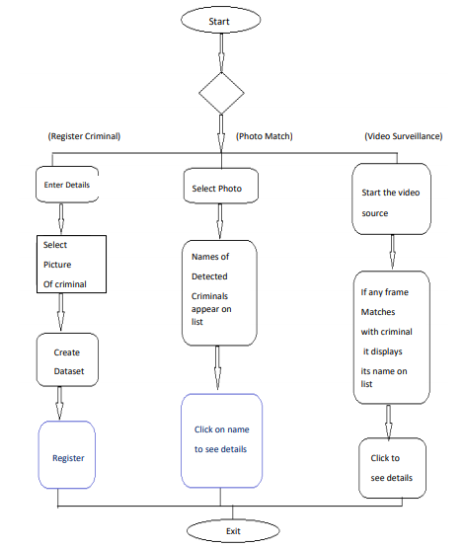
Process flow diagram of CFIS

Slide 18

Code

Slide 19
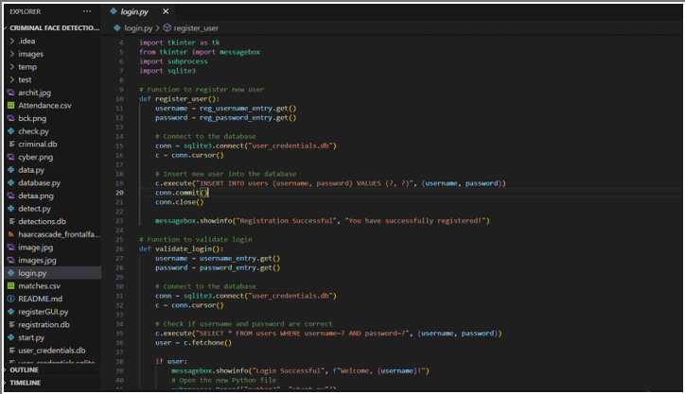

Slide 20
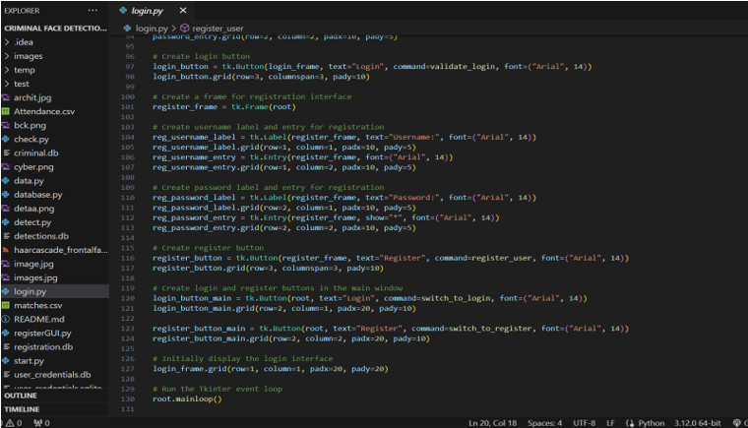

Slide 21
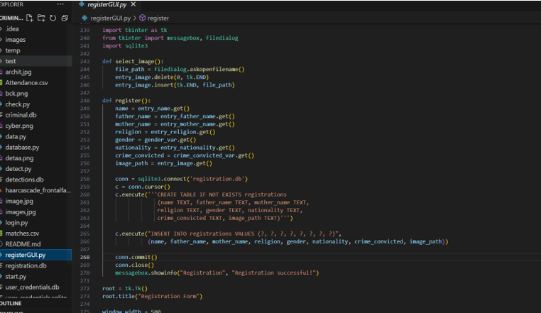

Slide 22
Results

Slide 23
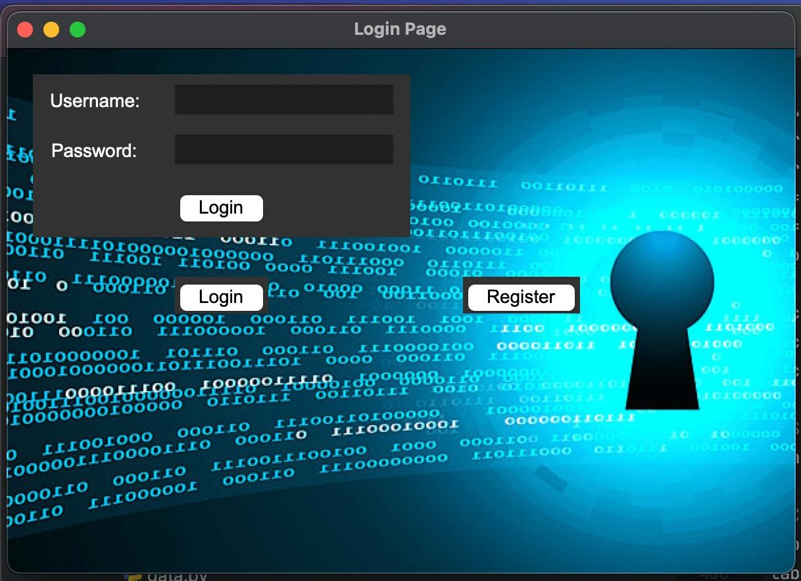

Slide 24
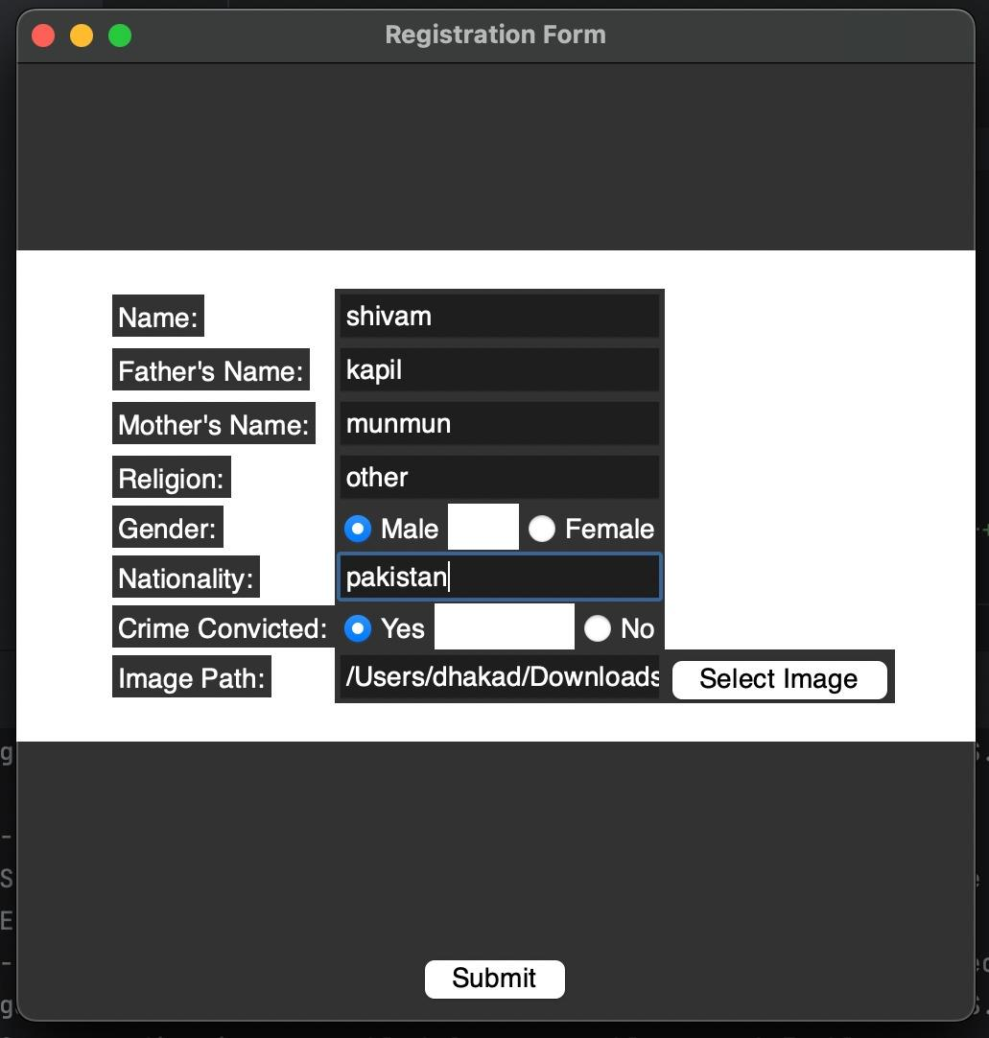

Slide 25
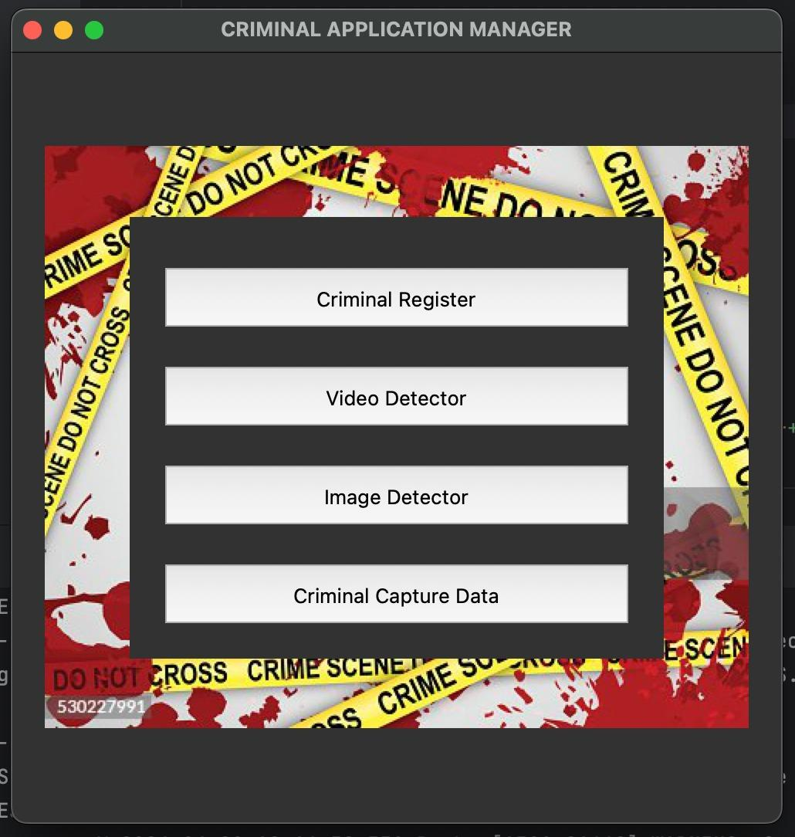

Slide 26
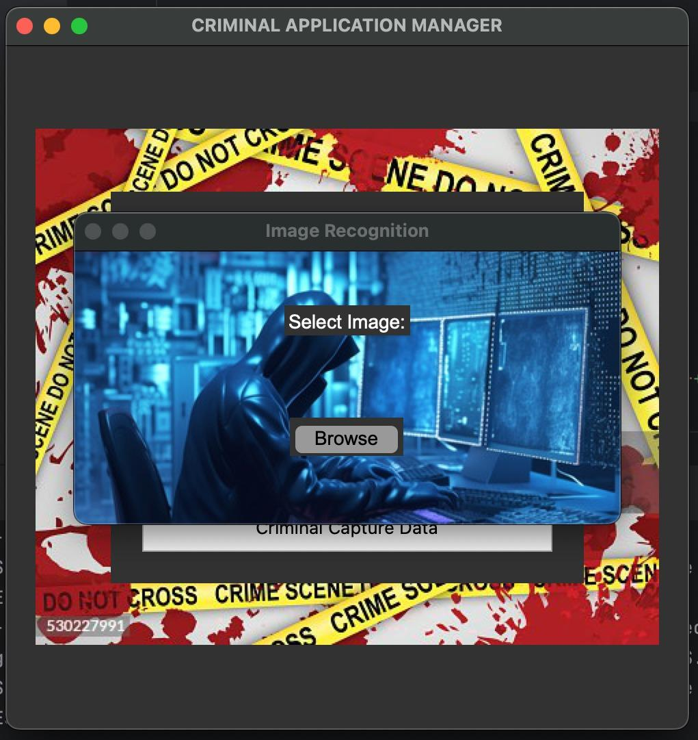

Slide 27
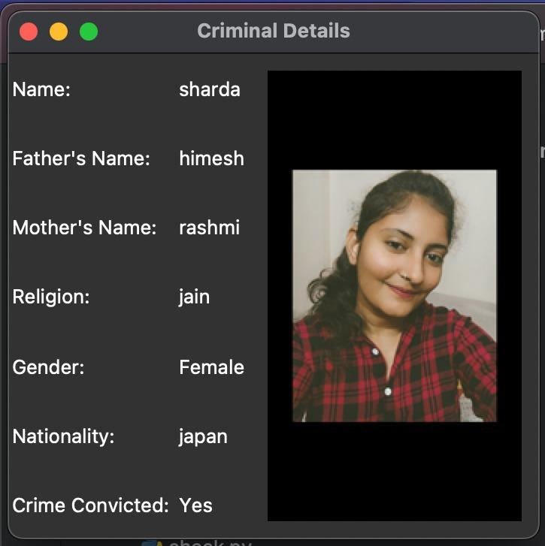
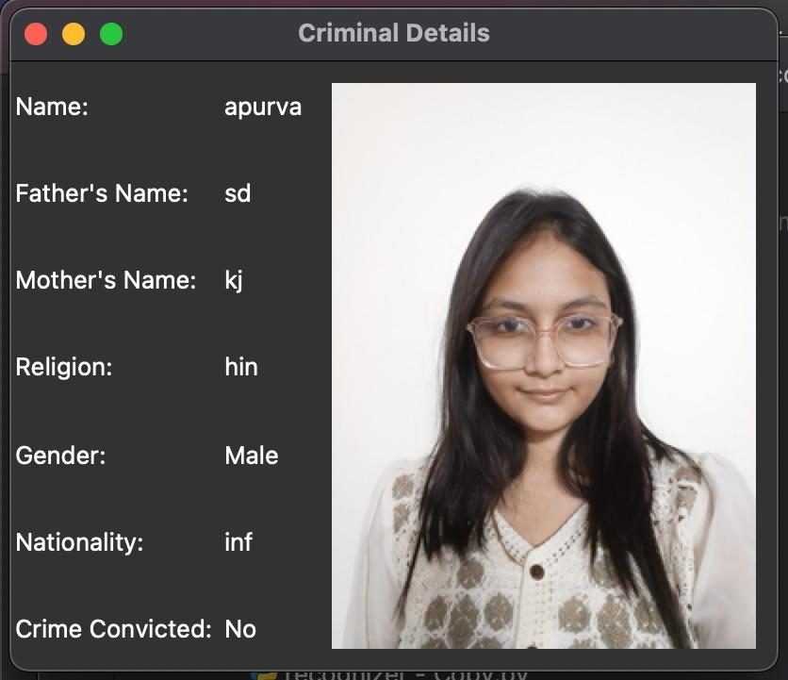

Slide 28
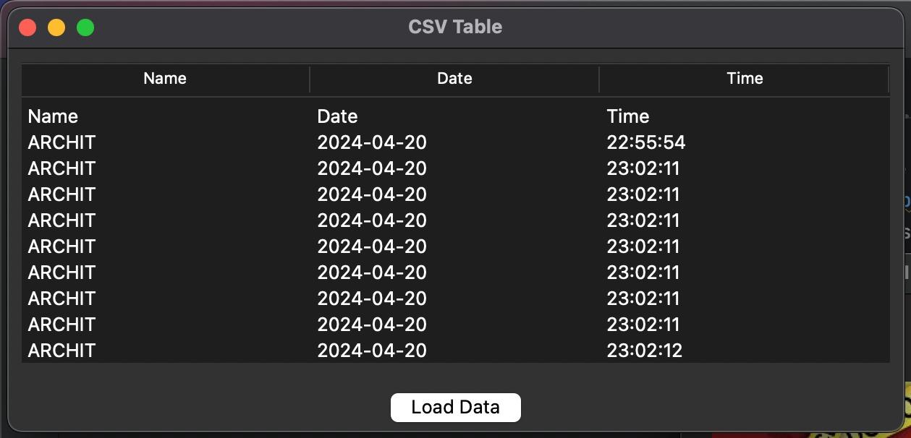

Slide 29
Conclusion
We have used Haar feature-based cascade classifiers in OpenCV approach for face detection. It is a machine learning based approach where a cascade function is trained from a lot of positive and negative images. And we have used Local Binary Patterns Histograms (LBPH) for face recognition. Also in this project we have used face recognition library build with deep learning having accuracy of more than 90%.
In this project, we are able to detect and recognize faces of the criminals in an image and in a video stream. And expecting the proper working of project in real environment.

Slide 30
Future work
Light normalization may allow the threshold value to increase.
Future work may include improvement of face recognition using specific character in the face (distance between eyes) and also analyze the face in 3D by using more than one camera. Using these two method the probability of error will decrease and system will be more accurate.

Slide 31
THANK YOU!

